Slide 1



Cache Architecture Simulator
Author: Awais Asghar

Slide 2
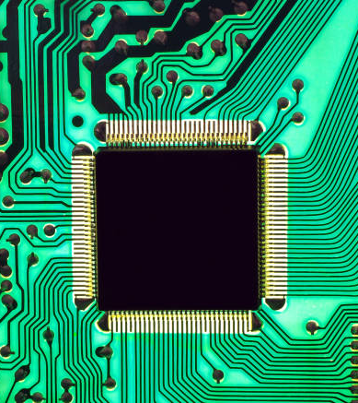
Introduction:
The "Memory Wall": CPU speeds have increased exponentially for decades. Main Memory (RAM) speed has not.
The Problem: A lightning-fast CPU is constantly forced to wait for slow RAM to deliver data.
The Solution: A Cache. A small, extremely fast (and expensive) piece of memory that acts as a buffer between the CPU and RAM.
The Goal: Store the right data in the cache before the CPU needs it.

Slide 3

Application: Why Caches Matter
Caches are one of the most important performance components in all of computing.
Hardware (L1/L2/L3 Caches): Every modern CPU (in your laptop, phone) has multiple levels of caches built directly onto the chip.
Software (Operating Systems): The OS uses a "page cache" to keep parts of files from the slow hard drive in fast RAM.
Web Browsers: Your browser caches images, CSS, and JavaScript to make websites load instantly on your next visit.
Databases: Databases cache common query results in memory to avoid re-calculating them.
The core principle is the same everywhere: avoid a slow operation by storing a copy in a fast place.

Slide 4

Literature Review
Why Caches Work: The Principle of Locality
Temporal Locality (Time): Data accessed once is likely to be accessed again soon (e.g., loop counters).
Spatial Locality (Space): Data near an accessed item is likely to be accessed soon (e.g., array elements).
How Caches Work: Address Mapping
A memory address is split into: Tag, Set Index, and Block Offset.
Set Index (s): Selects the cache row (the "set").
Tag (t): Uniquely identifies the data within that set.
Associativity (E): The number of lines ("ways") per set. A higher E reduces conflicts but increases complexity.

Slide 5

Problem Statement
The Design Problem: How can we predict if a new cache design (e.g., 4-way vs 2-way) will be fast before we spend millions building the hardware?
The Optimization Problem: When a cache set is full and a miss occurs, we must evict a block to make room. Which block should we kick out?

Slide 6

Solution: Cache Simulator
To solve the Design Problem, I built a cache simulator (csim.c) from scratch.
Function: It mimics the behavior of a hardware cache in software.
Input: Cache configuration (S, E, B - from command line).
A memory trace file (from valgrind) containing a list of all memory accesses a program makes.
Core Logic: For each memory access (L, S, M):
Calculate the tag and set index from the address.
Search the simulated cache (a 2D array of structs) for a tag match in the correct set.
Output: A summary of hits, misses, and evictions. This allows us to "grade" any cache configuration.

Slide 7
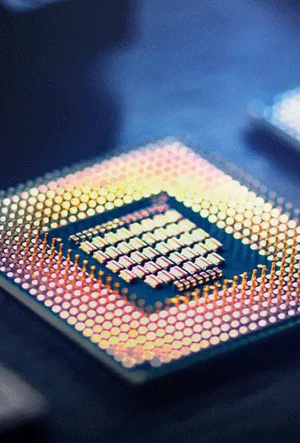
Solution: The Replacement Policy
To solve the Optimization Problem, I implemented a smart replacement policy.
The Baseline Policy: The provided simulator had a "dumb" policy: always evict Way 0.
The Implemented Policy: Least Recently Used (LRU).
Idea: Evict the block that hasn't been accessed for the longest time.
Why? This is a direct application of Temporal Locality. If a block hasn't been used in a while, it's "cold" and likely not needed again.
Implementation:
Added a counter or timestamp to every cache line.
On any access (a hit or a new block load), that line's counter is reset to 0 (or a high "most recent" value).
All other counters in the set are incremented ("aged").
On an eviction, the cache_flush function now finds and evicts the line with the highest (oldest) counter.

Slide 8

Visualizing the Cache
Let's use a visual tool (like the UW CSE351 Simulator) to see this in action.
Configuration:
Cache Size: 8 lines
Associativity (E): 2-Way (2 lines per set)
Sets (S): 4 (8 lines / 2-way = 4 sets)
Policy: LRU

Slide 9
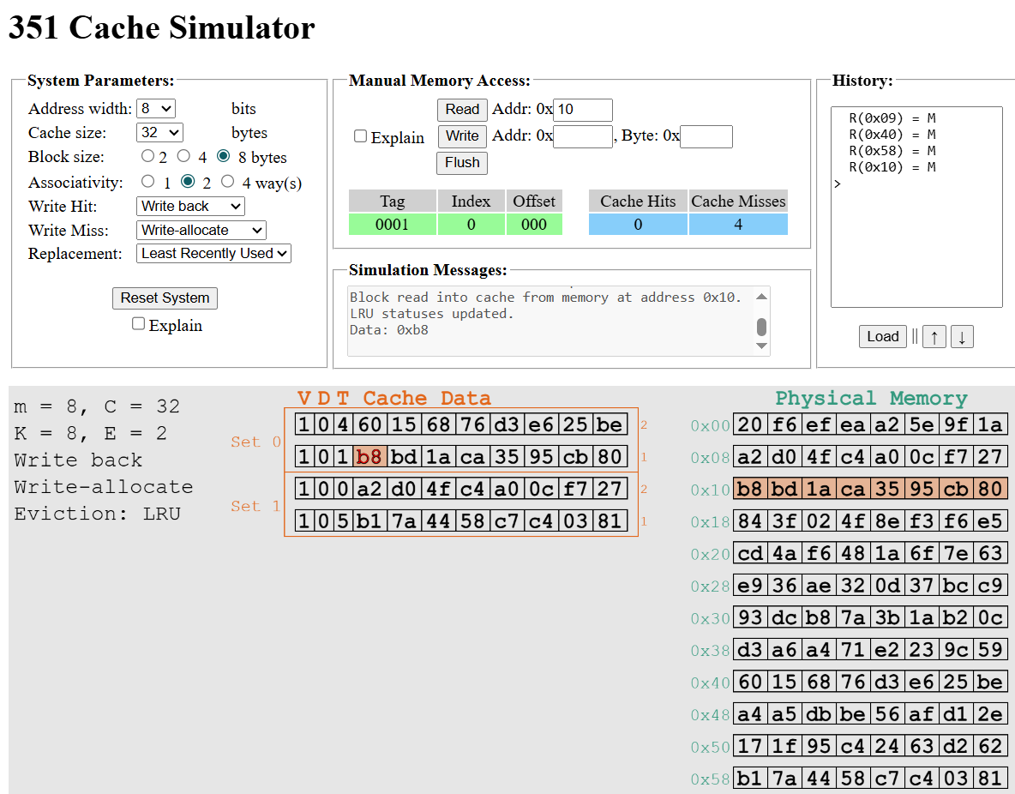

Slide 10

Methodology
Cache Configuration:
Total Size: 256 words
We tested multiple "shapes" (e.g., 256 sets/1-way, 128 sets/2-way, 64 sets/4-way).
Benchmarks:
exa.s: A benchmark with a mix of access patterns.
sort.s: A sorting algorithm, which has very high temporal locality.
Experiment:
Run exa.s and sort.s traces on all cache shapes using the Random (Way 0) policy.
Run exa.s and sort.s traces on all cache shapes using the LRU policy.
Measure the Miss Rate for all runs.

Slide 11
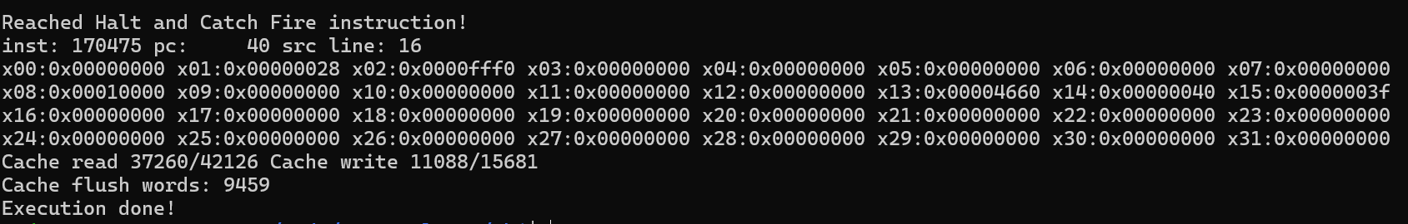
Results

Slide 12
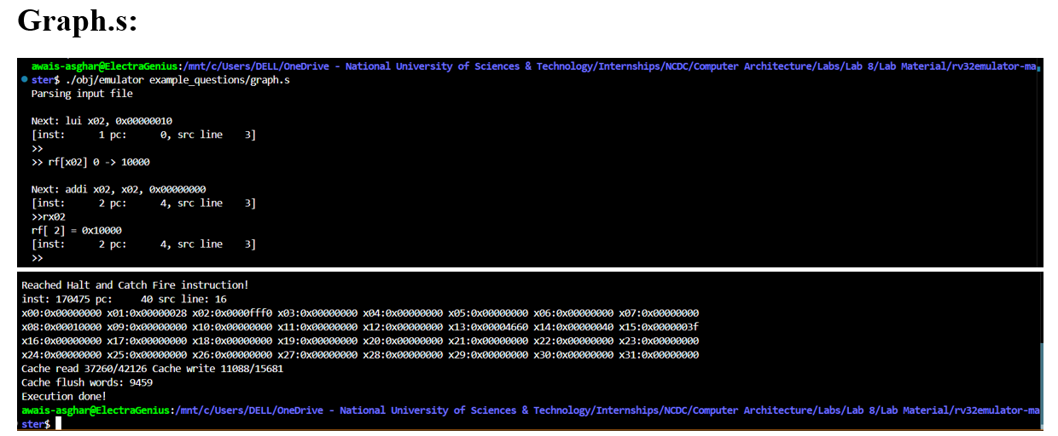
Random Replacement Policy

Slide 13
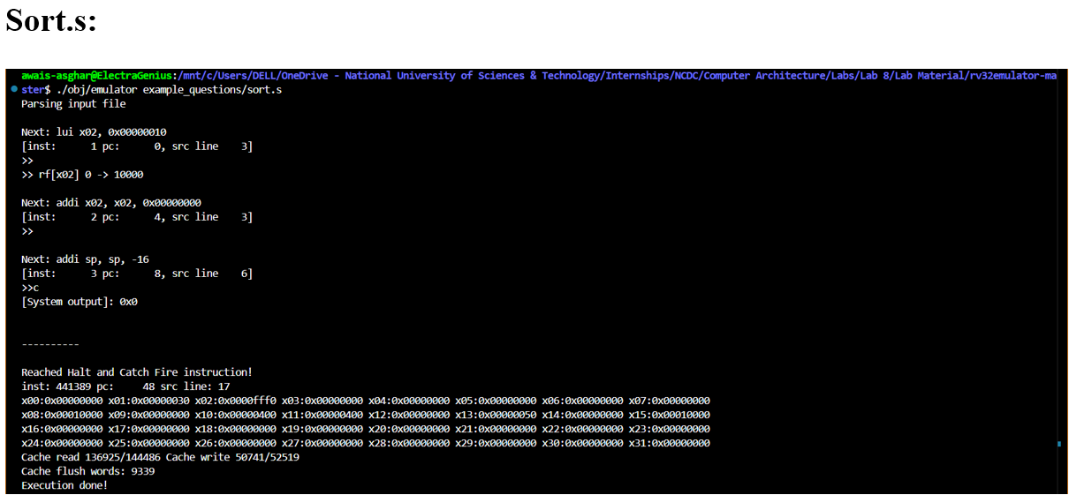

Slide 14
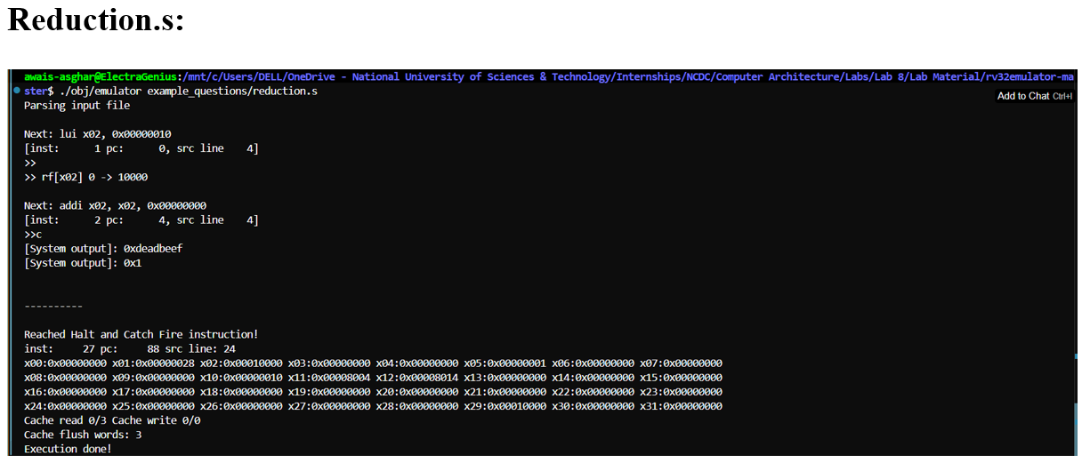

Slide 15
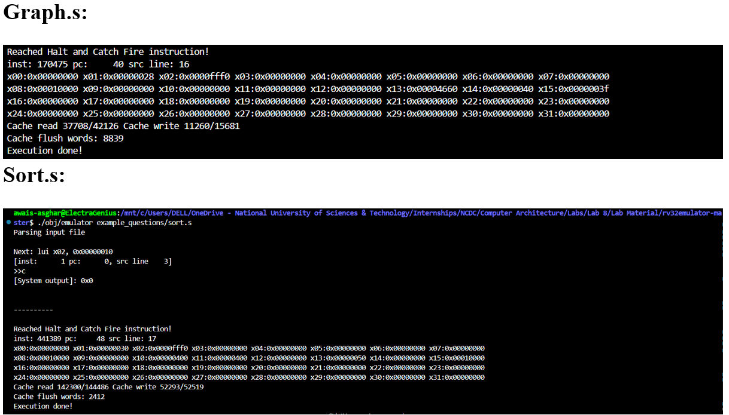
Least Recently Used Policy

Slide 16
Least Recently Used Policy

Slide 17
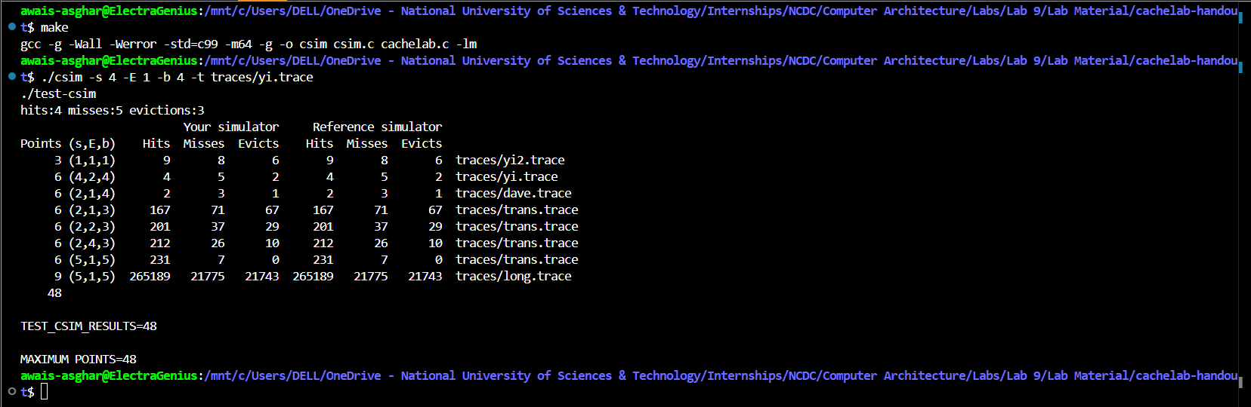
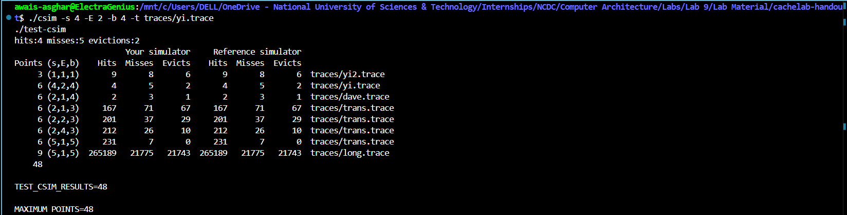
Least Recently Used Policy

Slide 18
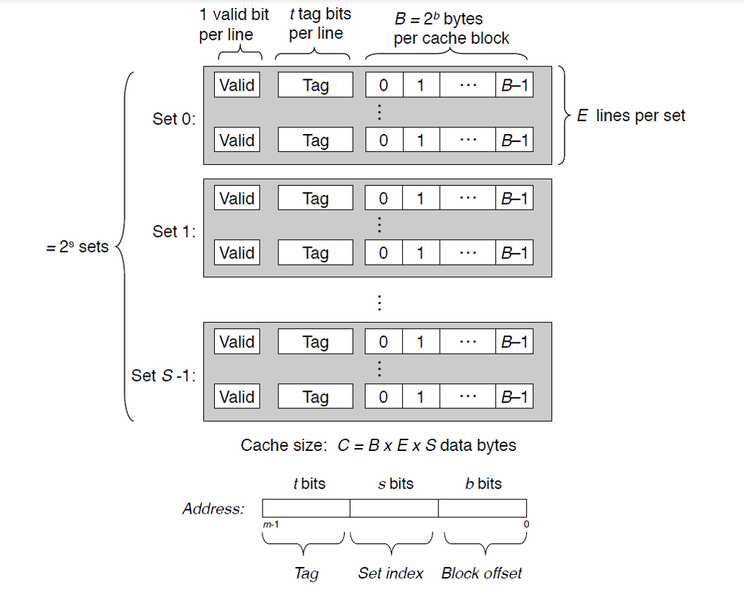

Slide 19

Analysis: The Power of Associativity
Finding 1 (Random Policy):
Best Configuration: Tended to be more sets, fewer ways (e.g., 256 Sets, 1 Way).
Finding 2 (LRU Policy):
Best Configuration: Tended to be fewer sets, higher associativity (e.g., 64 Sets, 4 Ways).

Slide 20
Conclusion:
Simulator Built: Successfully designed and built a functional cache simulator (csim.c) from scratch to model memory access traces and test cache designs.
Policy Implemented: Implemented the LRU replacement policy, replacing a naive "Way 0" eviction strategy to intelligently manage the cache.
LRU Outperforms Random: Our tests proved that for the same cache size, LRU achieves a significantly lower miss rate than a random policy.
Associativity Matters: The key insight is that smart policies (LRU) benefit most from flexible hardware (higher associativity), as it gives them more choices to optimize.
Simulation is Essential: This project demonstrates that simulation is a critical and cost-effective tool for validating and comparing architecture designs.

Slide 21
Future Improvements
Implement More Policies: Compare LRU against other common policies like LFU (Least Frequently Used), FIFO (First-In, First-Out), or hardware-friendly approximations like Pseudo-LRU.
Simulate Write Policies: Add support for "Write-Back" vs. "Write-Through" and "Write-Allocate" vs. "No-Write-Allocate" to model their impact on performance and memory bus traffic.
Model a Multi-Level Cache: Expand the simulator to a full memory hierarchy, including separate L1 Instruction/Data caches and a unified L2 cache.
Explore Cache Coherence: For a multi-core simulation, the next major step would be to implement a coherence protocol (like MESI) to manage data consistency across multiple caches.

Slide 22

Thank You

